Slide 1
What Info PC Does
Develop solutions and/or insights for clients (e.g. MINDEF, SAF) via analysis of open/closed source data
Exercise Forging Sabre 2019: Automatic Target Detection (ATD)
Deep learning model trained to analyse live surveilance footage to detect enemy/civilian vehicles

Slide 2
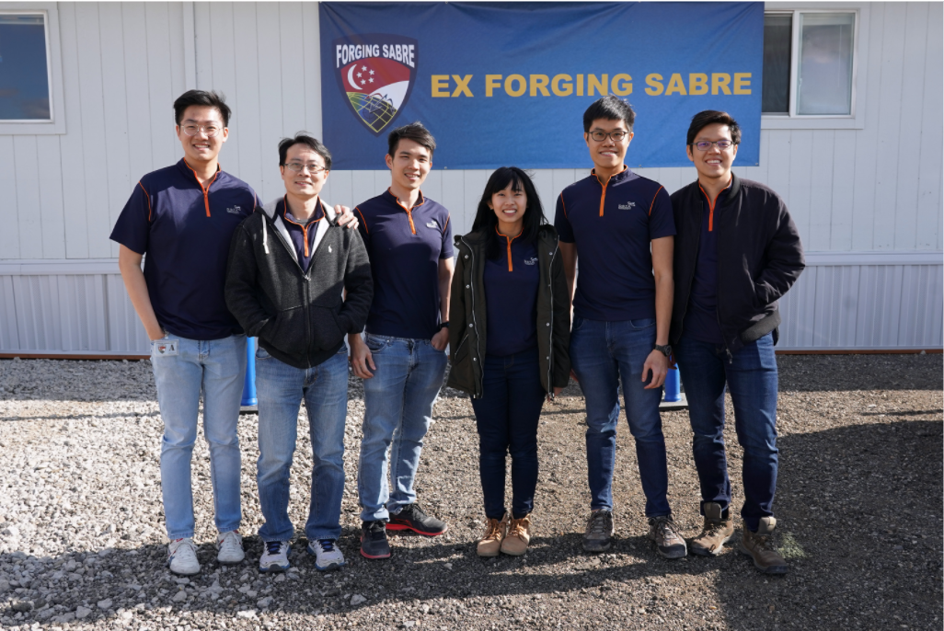

Slide 3
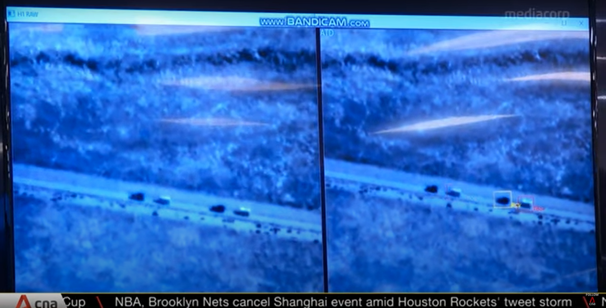

Slide 4
Main Challenges
Lack of Info! (Quality, Quantity or Both)
Due to the nature of DSTA's industry
In general, accurate insights or predictive models require a lot of data
Need for innovation and creativity to find alternatives/workarounds
E.g. Data Augmentation

Slide 5
One/Few Shot Learning
Problem: Accurately classifying foreign military assets given a single/few labelled samples
Conventional deep learning models trained to recognise specific objects (i.e. Is this X?)
Low generalising ability, unfeasible

Slide 6
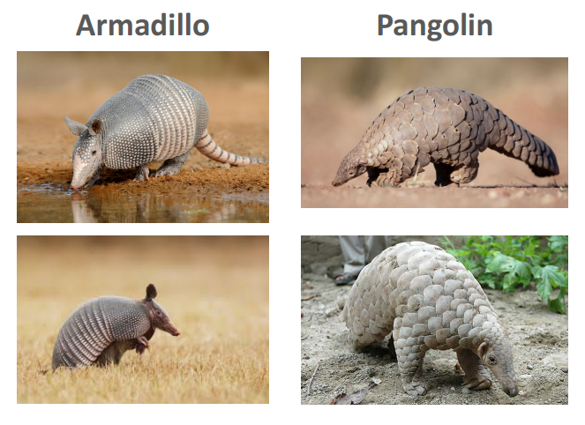

Slide 7
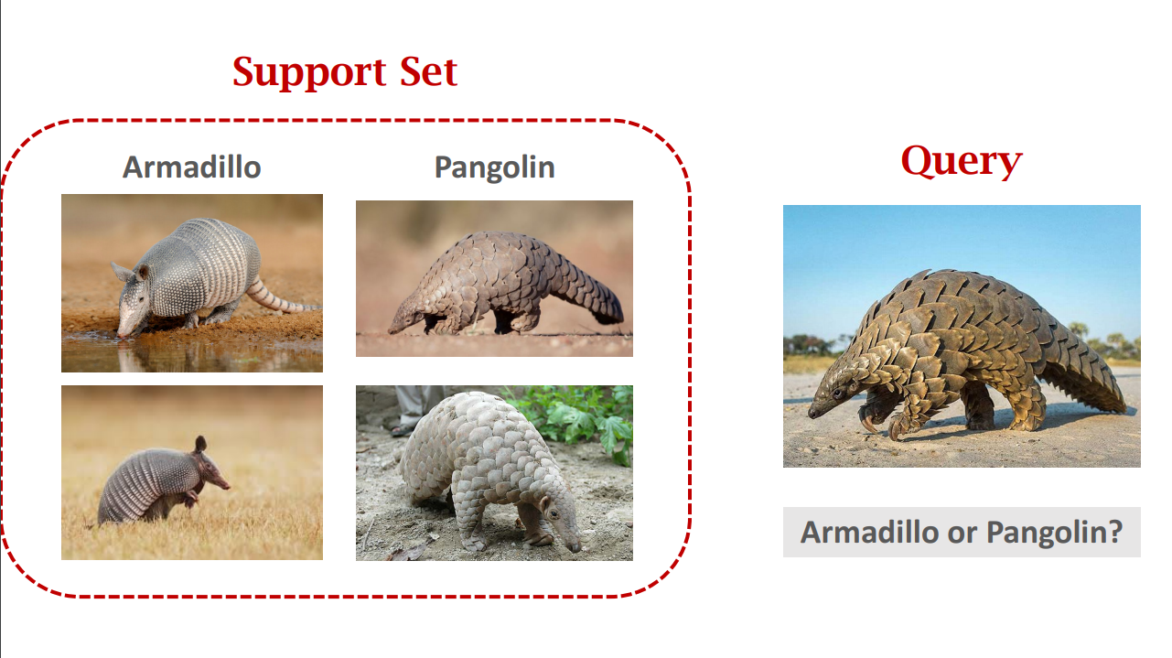

Slide 8
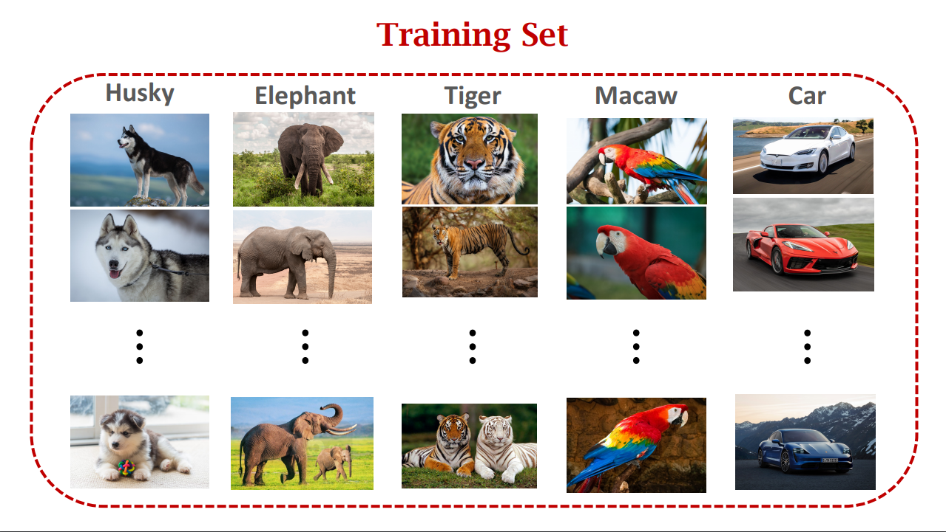

Slide 9
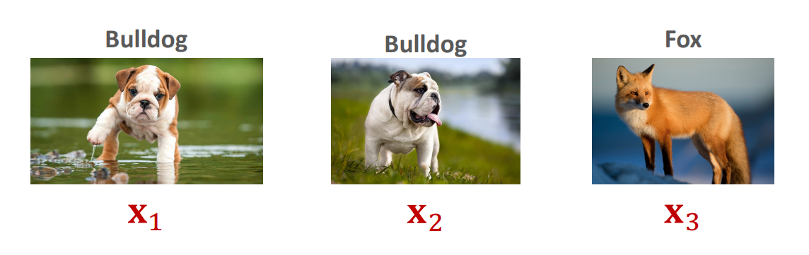
Solution
Train a model to differentiate objects, i.e. Is X similar to Y?
High generalising ability, feasible
f(x₁, x₂) = 1, f(x₁, x₃) = 0, f(x₂, x₃) = 0

Slide 10
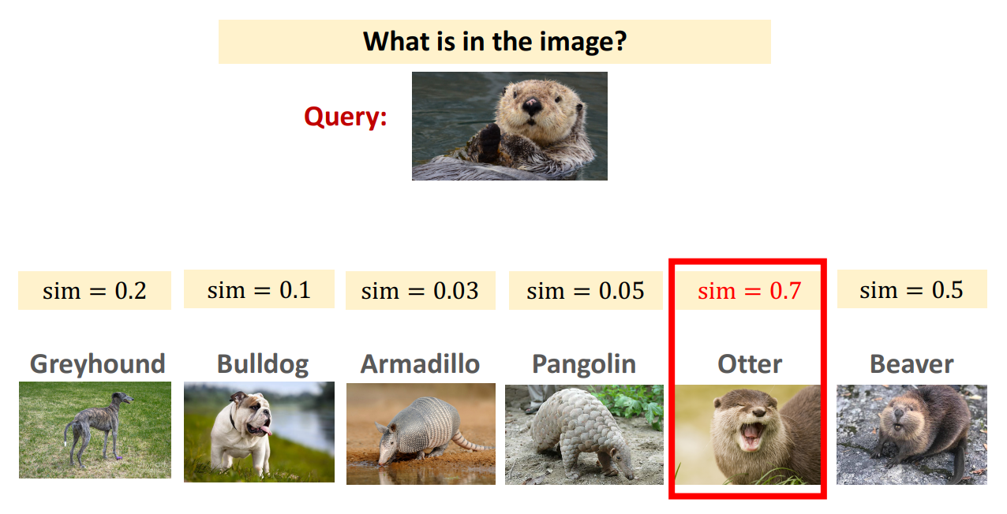

Slide 11
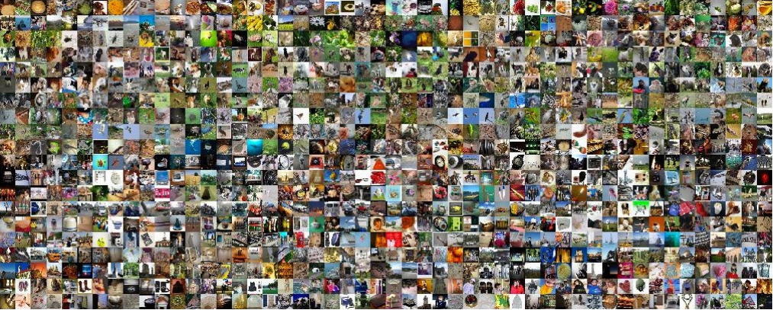
nC2 samples!
1000C2 = 499500

Slide 12
Credits
Images adapted from:
  https://www.dsta.gov.sg/programme-centres/information-pc/striking-smarter-and-faster
  https://github.com/wangshusen/DeepLearning

